Slide 2
Power Query, DAX, and Data Modelling Best Practices
Thabor Walbeek &
Pooja Shriwastav

Slide 3




Thabor Walbeek
Data Fanatic
Everything Data
Data analyst, BI, Data Science, Delivery Manager, Project Manager, Consultant About 20 years of experience of which more than 15 years in IT. Worked with all kinds of technologies in many different client environments and different countries. In India since 2011 and occasionally in Holland working on a range of different Data, BI and Analytical projects. With a no-nonsense mentality, I always try to have fun Specialties: Data Analysis, Data Science, BI, Project Management
Thabor.Walbeek@rapidcircle.com
https://www.linkedin.com/in/thaborwalbeek/
@Thabor09
https://www.facebook.com/twalbeek

Slide 4
Pooja Shriwastav
Power BI Enthusiast
Data Geek
Power BI, Data Analysis, Consultant
A data analytics enthusiast with 2+ years of experience in Data Analysis and Reporting.
Always curious about the data and means to convey information from it.
On the path of making this bio even more interesting!
Pooja.Shriwastav@rapidcircle.com
http://www.linkedin.com/in/pooja-shriwastav
https://twitter.com/ShriPooja_73
https://www.facebook.com/pooja.shriwastav.1

Slide 5
What is Data Modelling?
Importance of Data Modelling in Power BI and its significance to achieve efficient data schema

Slide 6
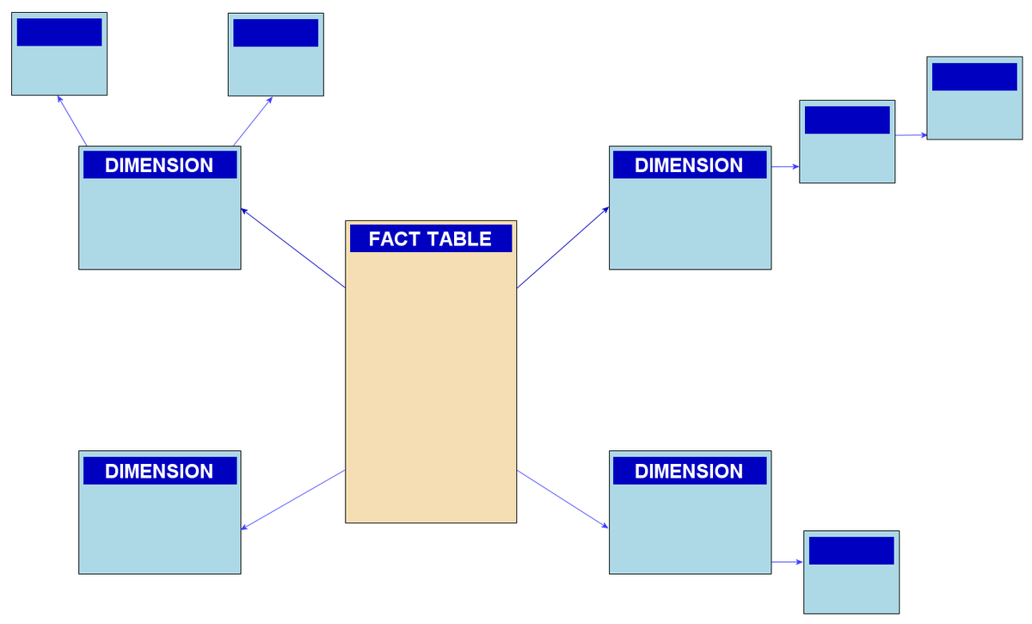
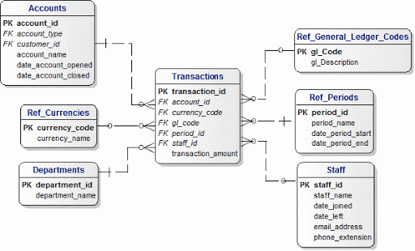
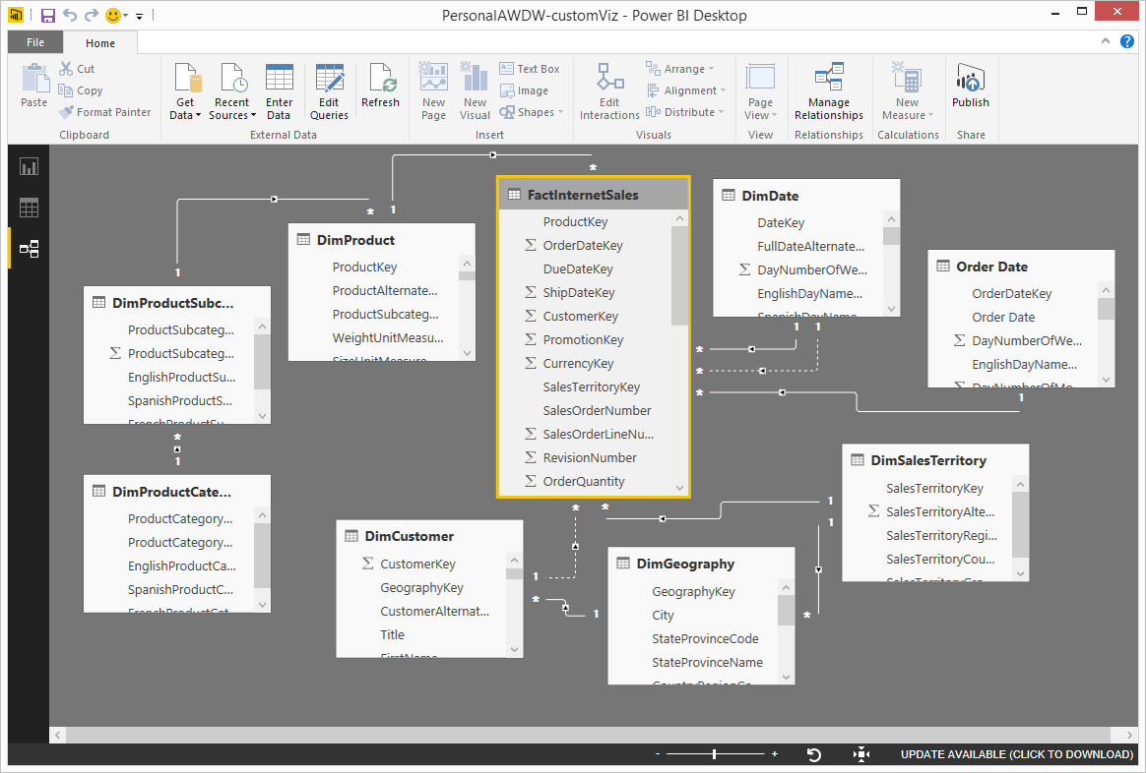
Snowflake Model
Star Model

Slide 7
Power Query and DAX
Comparing Power Query (M) with DAX and their individual roles in data transformations

Slide 8
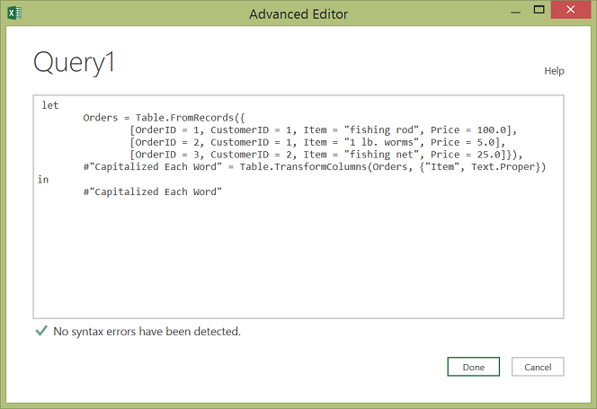
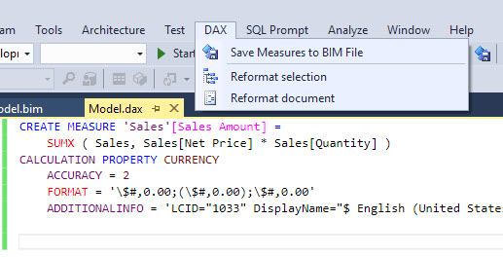
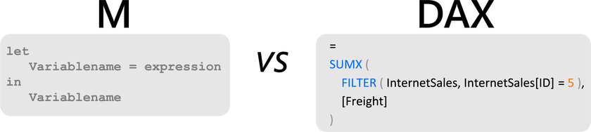

Slide 9
Power Query:
Power Query is the Microsoft Data Connectivity and Data Preparation technology that enables business users to seamlessly access data stored in hundreds of data sources.
Easy to use, engaging, and no-code user experience.
Data mashup and transformations are expressed using the Power Query M Formula Language.

Slide 10
DAX:
Data Analysis Expressions (DAX) is a library of functions and operators that can be combined to build formulas and expressions
Used in Power BI Desktop, Azure Analysis Services, SQL Server Analysis Services, and Power Pivot in Excel.
DAX helps you create new information from data already in your model.
Dynamic functions like aggregations, conversions, and complex mathematical expressions can be created using DAX.

Slide 11
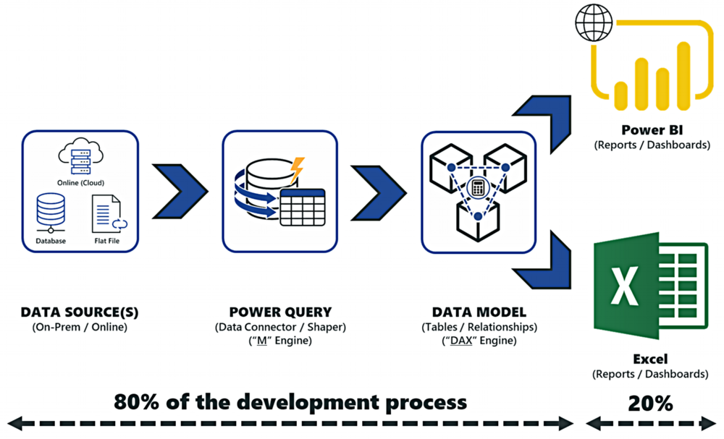
When to choose Power Query over DAX

Slide 12
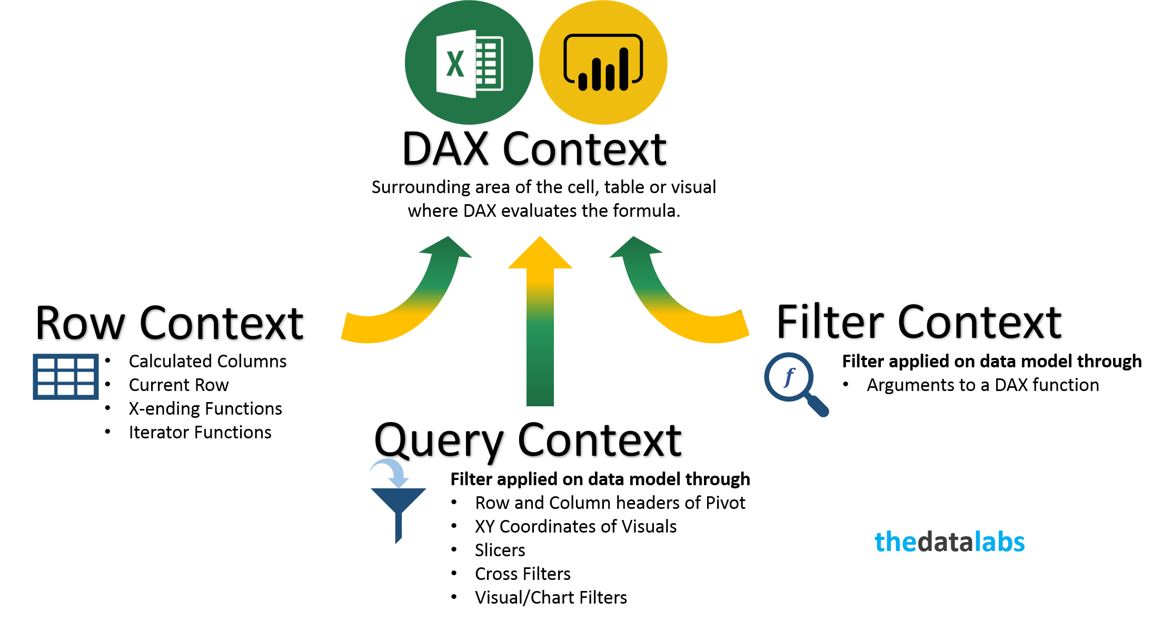
Complexity of DAX Row and Filter Context

Slide 13
Import and Direct Query
Understanding the functionalities of most common methods used for connecting to database

Slide 14
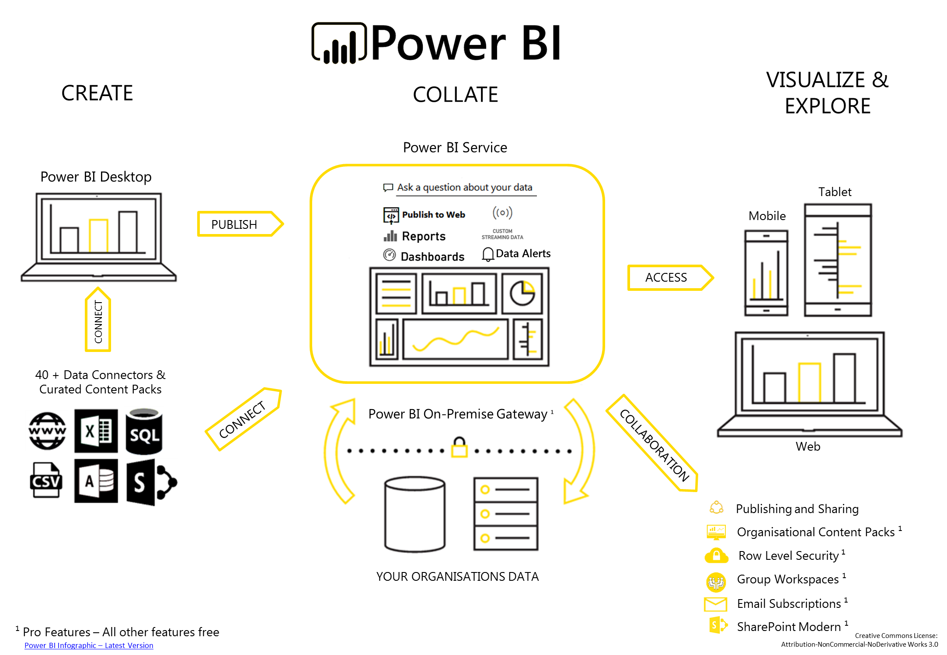
Power BI Architecture

Slide 15
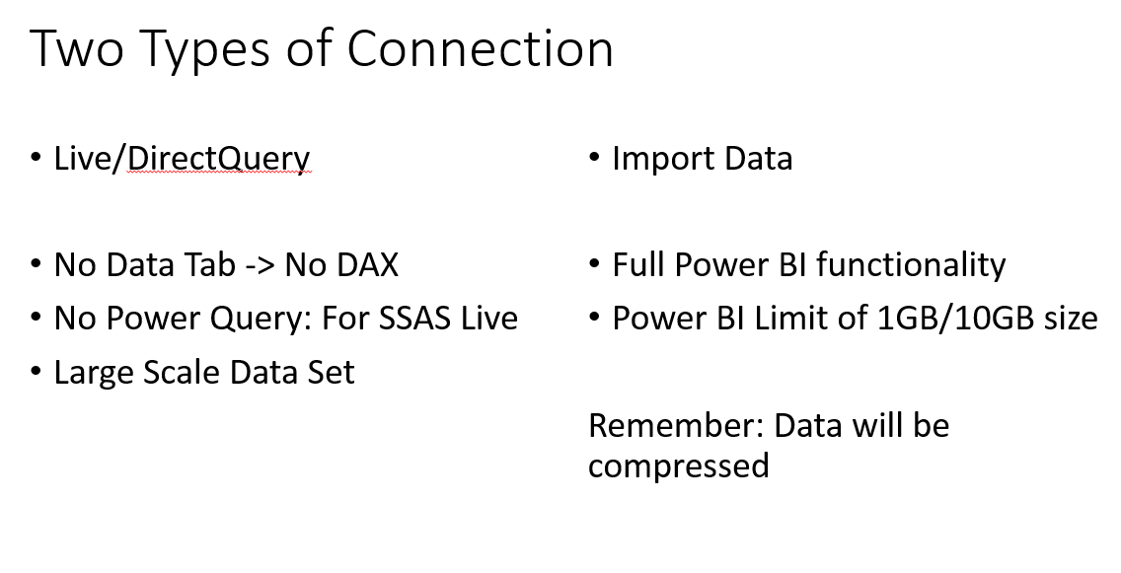
Connection Types

Slide 16
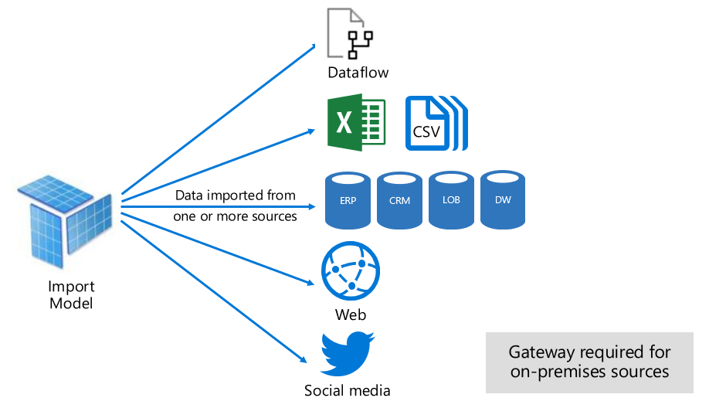
Import Model:
Image courtesy: Microsoft

Slide 17
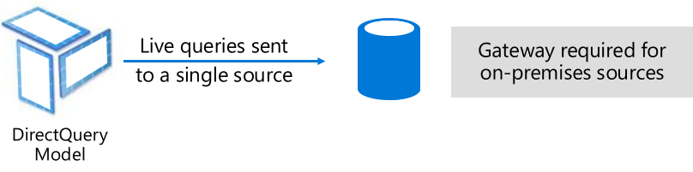
Direct Query Model:
Best when data is changing frequently, and reports must reflect the latest data.
Direct Query is only feasible when the underlying data source can provide interactive queries and can handle the query load that will be generated.
Image courtesy: Microsoft

Slide 18
Limitations to Direct Query:
Cannot merge, split columns
No Q&A for Direct Query
Cannot create calculated columns in report view
Not much options available for data transformation
Need to make needed changes in the data source directly

Slide 19
Best practices for data transformation
Implementing these practices for efficient and easy-to-understand Power BI reports and data models

Slide 20
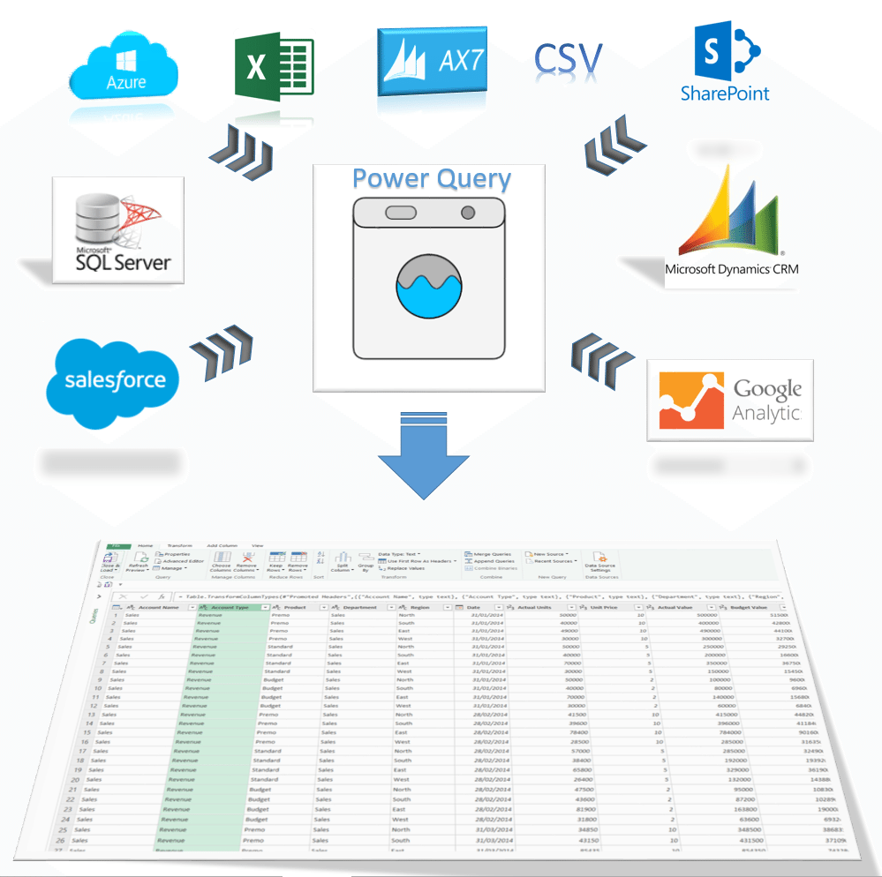

Slide 21
Keep the tables short and crisp.
Disable load of the merged source tables.
Avoid Many-to-many / bidirectional relationships.
Combine the tables with one-to-one relationship.
Smaller models achieve faster data refresh, resulting in lower latency, higher dataset refresh throughput, and less pressure on source system and capacity resources.

Slide 22
Only use DAX Calculated Columns when it’s not possible to create it using Power Query.
This improves clarity and manageability of your report as transformations are located where you expect them.
Improves query speed of the model and reduces refresh duration.
Using Power Query for data transformations is always the preferred way.

Slide 23
From Scratch to Smash!
A walkthrough data modelling and transformations to see the difference of implementing best practices to get awesome Power BI reports.

Slide 24

Time to grab a Goodie
What are the two main types of data modelling schemas?
Answer: 1. Star Schema
2. Snowflake Schema

Slide 25
Time to grab a Goodie
Why do we do Data Transformations?
Answer:

Slide 26

Enjoy the Bootcamp

Slide 27
Call to action
Start a Power Platform learning path at https://docs.microsoft.com/en-us/learn/powerplatform/
Join Office 365 developer program https://dev.office.com/devprogram to leverage all resources for Office 365 development learning
Build applications on Power platform
Attend local community events to continue learning on Power Platform development

